Slide 1
Machine Learning
Introduction
By Adwait Bhave

Slide 2
Agenda
Introduction
1
Machine Learning Basics
2
Machine Learning key ideas
3
Machine Learning Case Studies
4
Q&A
5

Slide 3
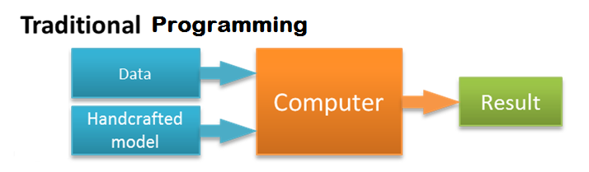
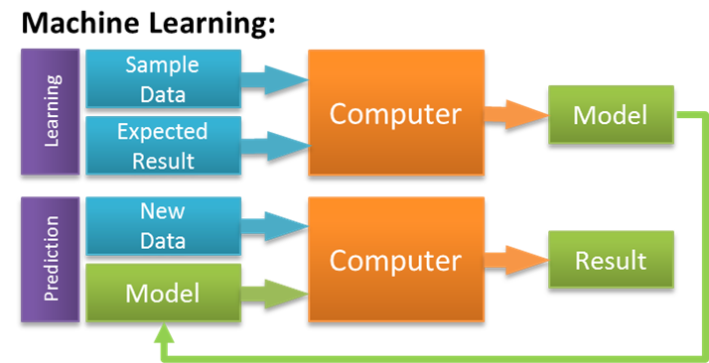
What is machine learning?
Computer Program : A computer program is a collection of instructions that performs a specific task.
Machine Learning : Create a computer program by learning from examples of input/output combinations.*

Slide 4
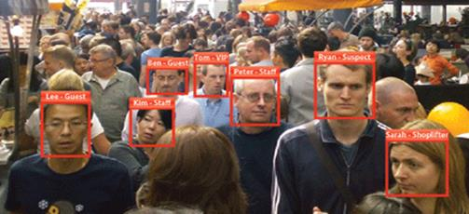
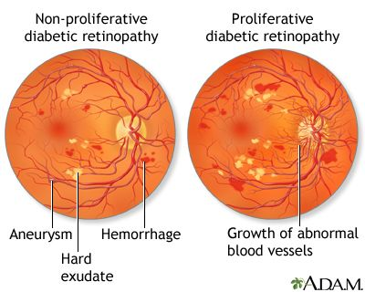
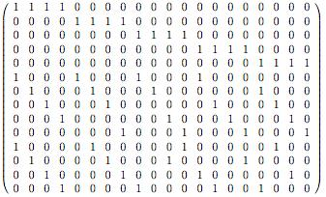
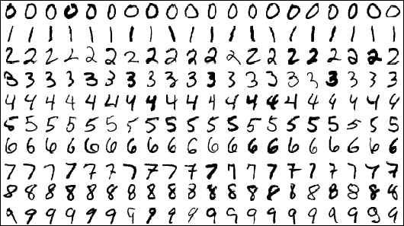
When to use machine learning?
Netflix 1M$ problem
Number of users (Anonymous) = 480,189
Number of movies rated by them = 17,770
Experts know how to do it, but the expertise is very costly.
We can learn how to do it, but there is just too much of data and many hidden patterns.
We don’t know how we do it, but we do it all the time.

Slide 5

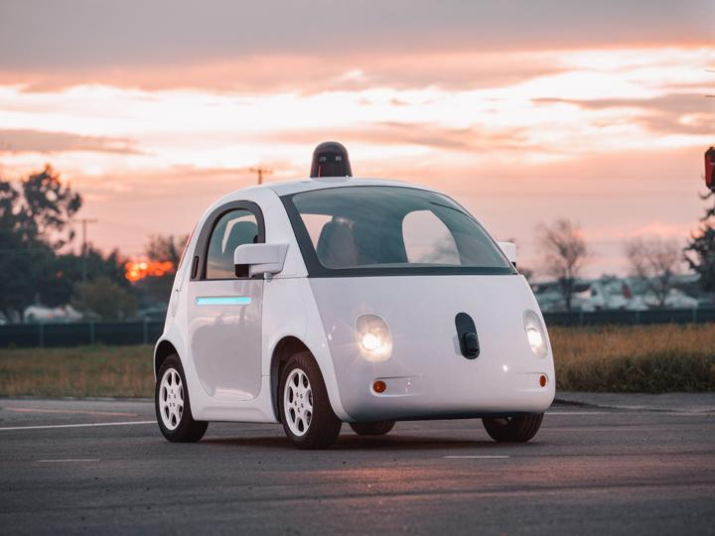
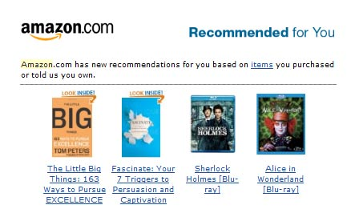
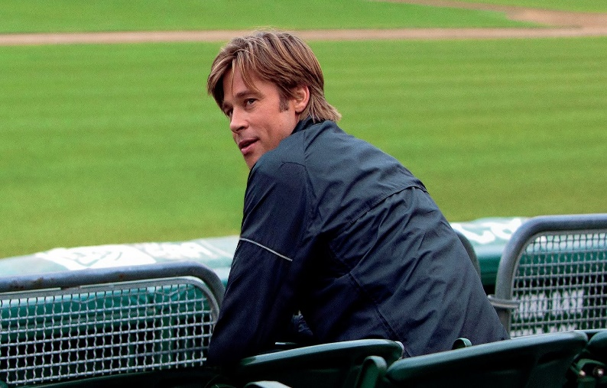
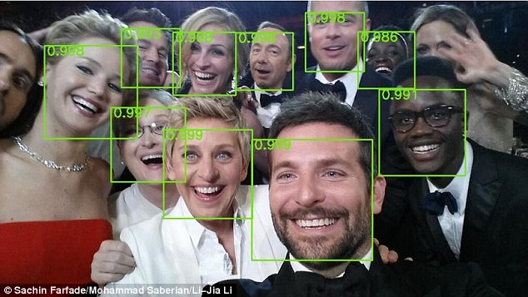
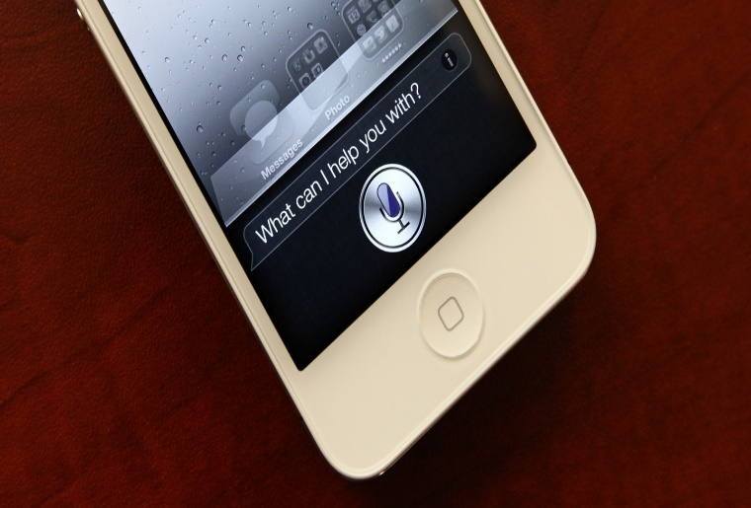
Popular Machine Learning

Slide 6
Why we see the buzz now?
Business need for smarter, human level communication. Demand for self-customization.
Data availability and improved data capture (New sensor devices).
Faster computers, specialized processors for fast math operations.
Many researchers from physics, astronomy, biology and economics bringing algorithms from their domains formulating it as a prediction problem.
Increased media coverage. Increased research and start-up funding.
Evolution of easy to use software – R and Python libraries for many popular algorithms.
Massive unstructured datasets.

Slide 7
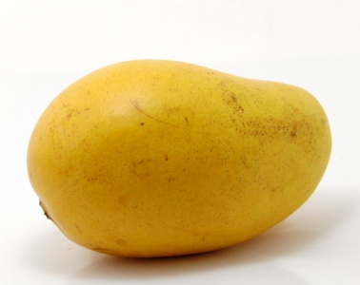
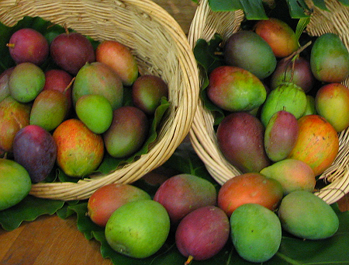
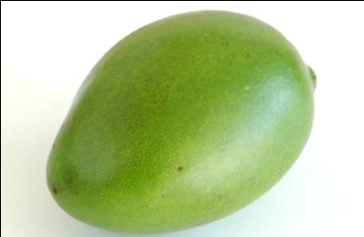
Mango problem
ID | Image (16*16) | Weight | Size | Label
1 | [[0.78,0.89..], [0.2…..]] | 300 | 3.7 | Ripe
2 | [[0.18,0.08..], [0.1…..]] | 250 | 2 | Raw
3 | [[0.22,0.11..], [0.9…..]] | 100 | 3 | Raw
4 | [[0.88,0.49..], [0.2…..]] | 250 | 5 | Ripe
Training Set
ID | Image (16*16) | Weight | Size | Label
1 | [[0.12,0.11..], [0.001…..]] | 300 | 4 | ?
2 | [[0.1221,0.18..], [0.1…..]] | 170 | 2.1 | ?
3 | [[0.22,0.01..], [0.23…..]] | 200 | 2.65 | ?
4 | [[0.28,0.29..], [0.2…..]] | 150 | 4.9 | ?
Test Set

Slide 8
ID | Image (16*16) | Weight | Size
1 | [[0.12,0.11..], [0.001…..]] | 300 | 4
2 | [[0.1221,0.18..], [0.1…..]] | 170 | 2.1
3 | [[0.22,0.01..], [0.23…..]] | 200 | 2.65
4 | [[0.28,0.29..], [0.2…..]] | 150 | 4.9
ID | Image (16*16) | Weight | Size
1 | [[0.78,0.89..], [0.2…..]] | 300 | 3.7
2 | [[0.18,0.08..], [0.1…..]] | 250 | 2
3 | [[0.22,0.11..], [0.9…..]] | 100 | 3
4 | [[0.88,0.49..], [0.2…..]] | 250 | 5
Label
Ripe
Raw
Raw
Ripe
Ripe
1
0
0
1
Model
ML Algorithm (Classifier)
Probability of Ripe
0.87
0.07
0.65
0.35
Predicted Label
Ripe
Raw
Ripe
Raw
Model
> 0.5

Slide 9
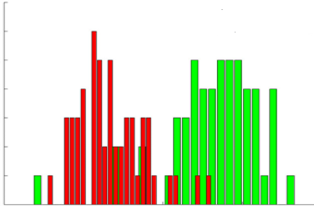

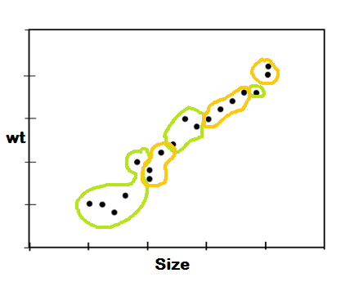
Features and Model
Differentiate in raw and ripe mangoes using weight.
Use intensity histograms of images
Size and Weight
Combination of these three can create a good classifier – image being the ‘golden’ feature.
Model is the best fit approximation of the three parameters.

Slide 10
Definition again
Machine learning is programming to optimize a performance objective using representative data samples.
Three ingredients of machine learning problem
There is a task which you want to get better at/optimized.
There is an objective which can be defined and measured.
There are representative examples a.k.a. training data.

Slide 11
More Examples…
Task : Categorize email messages as spam or normal.
Objective : Minimize percentage of email messages incorrectly classified.
Training data : Database of emails human-given labels.
Task : Recognizing hand-written words
Objective : Minimize wrongly classified words
Training data : Database of human-labeled images of handwritten words
Task : Playing go
Objective : Minimize percentage of games
Training Data : Practice games data (Moves -> Result)
Task: Driving on highways using vision sensors
Objective : Maximize distance traveled before a human-judged error
Training data : A sequence of images and steering commands recorded on a human driver.

Slide 12
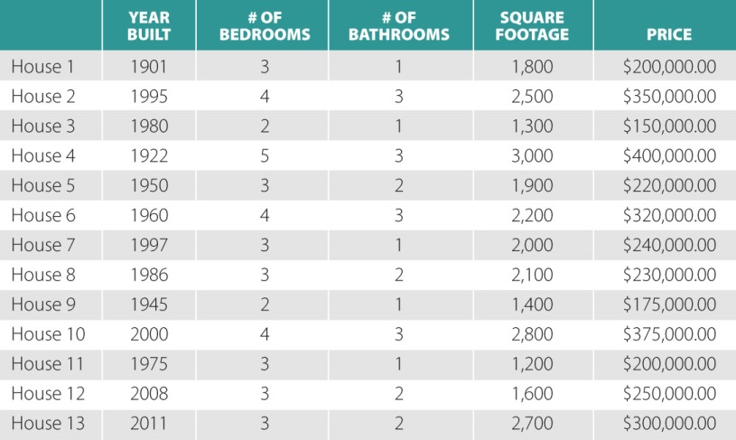
ML use case characteristics
We believe that there is a process explaining the data. We don’t know the details about the process but we suspect that it’s not random. [hidden process]
We have collected the input-output data of that process. Example Data (Input -> Output) is available, cheap and abundant.
We are ok with the useful approximation of the hidden process.
There are many possible characteristics of the Example data.
We expect to find new examples in future and like to get result for the same.

Slide 13
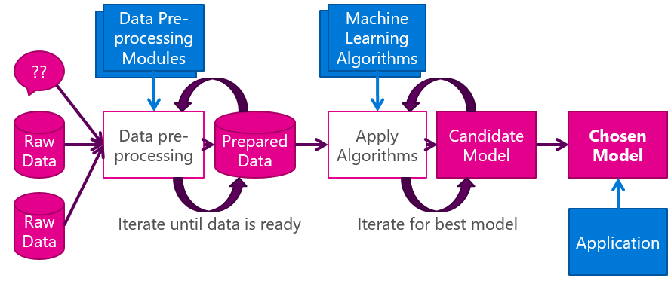
ML Process
1. Understand domain, available data, and goals. formulating problem in terms of data (features and target) and objective to optimize.
2. Data engineering (integration/cleaning/processing)
3. Statistical exploration of data - building ideas (features)
4. Feature engineering - representing data in different way may help the optimization objective. (square/roots/ many weird heuristics, encoding)
5. Develop idea about which family of algorithms suitable for the problem
6. Trial and error (fit model, evaluate)
7. Find where you can improve - features/ math transformation/ valid assumptions/ efficiency
8. loop till you solve the problem useful approximation.
9. Visualizing the results/ building story

Slide 14
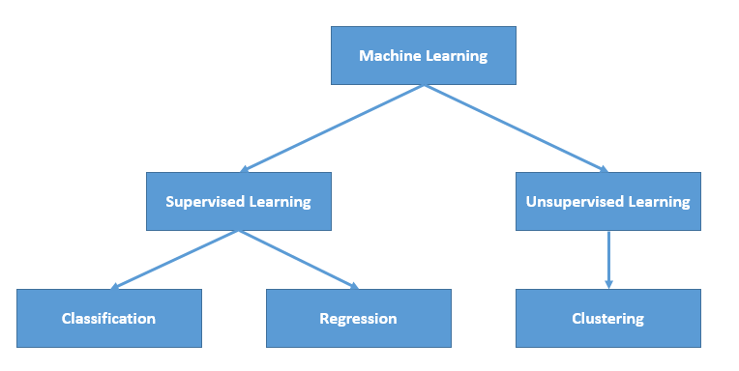
Machine Learning Algorithms*

Slide 15
Classification Examples
Classify examples into given set of categories.
Predict the type of crime likely to occur given neighborhood , location and date/time information. {assault, homicide, robbery, dui, warrant}
Target a set of customers likely to buy a new product. {Buy, don’t buy}
Target a set of voters likely to vote for a party.
Character Recognition {Language characters}
Detect duplicate advertisements/ questions / posts.
Classify plants, animal species, galaxies.

Slide 16
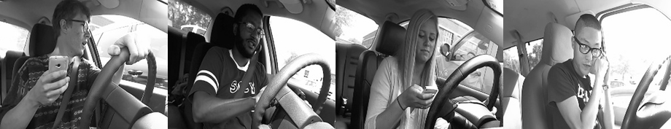
State Farm Distracted Driver Detection
c0: safe driving
c1: texting - right
c2: talking on the phone - right
c3: texting - left
c4: talking on the phone - left
c5: operating the radio
c6: drinking
c7: reaching behind
c8: hair and makeup
c9: talking to passenger
You are given driver images, each taken in a car with a driver doing something in the car (texting, eating, talking on the phone, makeup, reaching behind). Your goal is to predict the likelihood of what the driver is doing in each picture.

Slide 17
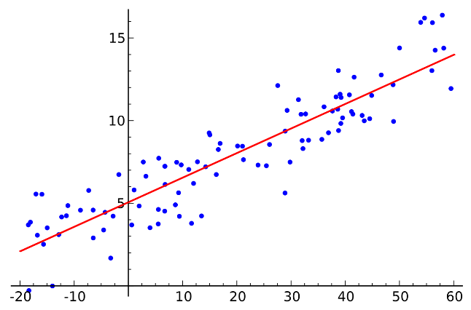
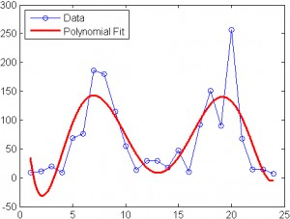
Regression examples
Each record also has a continuous response variable. {price, vote share, sales, rainfall, stock price}
Estimate market value of homes
Predict voting patterns in elections.
Predict sales volume of new product based on advertising expenditure.
Predict weather patterns as a function of temperature, humidity, air pressure, etc.
Prediction of stock movements.
Notes:
Obama campaign in 2012 invested $100 million in data analytics. Several hundred staffers for 18 months plus lots of digital technology, new data gathering tools.

Slide 18
Unsupervised Learning
Given only unlabeled data as input, learn some sort of structure
The objective is often vague or subjective than in supervised learning. This is more of an exploratory/descriptive data analysis
Clustering
Discover groups of ‘similar’ data points
Quantization
Map a continuous input to a discrete (more compact) output
Density estimation
Find a function that approximates the probability density of the data (i.e., value of the function is high for “typical” points and low for “atypical” points)

Slide 19
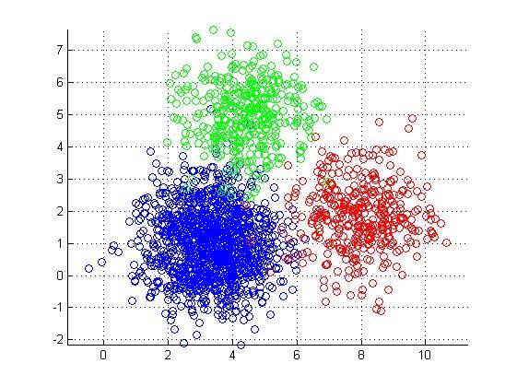
Clustering
Clustering is:
Grouping a similar objects based on a definition of similarity
That is, intra vs. inter cluster similarity, e.g. distance from center of the cluster
Use when:
Class labels are not available, but you have a desired number of clusters in mind
Variations:
Different similarity measures
Automatic detection of number of clusters
Streaming data
Intra-cluster distances are minimized
Inter-cluster distances are maximized

Slide 20
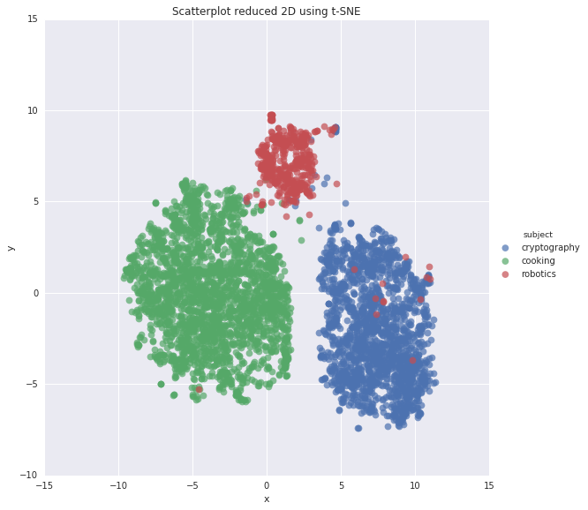
Document Classification

Slide 21
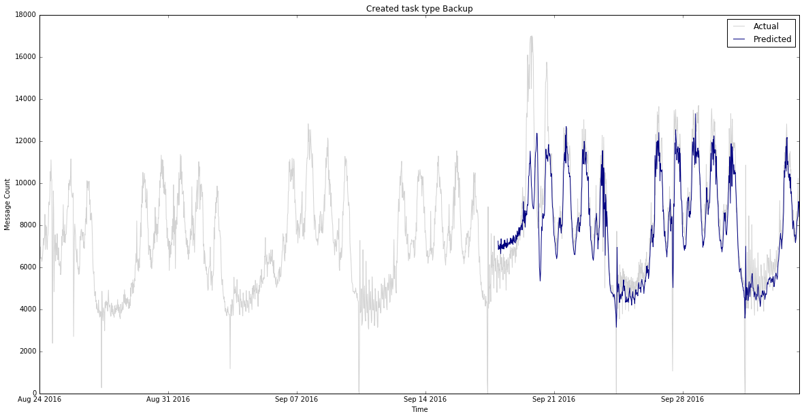
Unusual Activity / Anomaly

Slide 22
Q&A

Slide 23
Thank you

Slide 24
Links and references - 1
Show me some code (Python):
1) Classification : http://scikit-learn.org/stable/auto_examples/linear_model/plot_logistic_multinomial.html#sphx-glr-auto-examples-linear-model-plot-logistic-multinomial-py
2) Regression : http://scikit-learn.org/stable/auto_examples/linear_model/plot_ols.html#sphx-glr-auto-examples-linear-model-plot-ols-py
3) Clustering : http://scikit-learn.org/stable/auto_examples/cluster/plot_kmeans_digits.html#sphx-glr-auto-examples-cluster-plot-kmeans-digits-py

Slide 25
Links and references - 2
Videos
1) Theory + hands on : https://www.youtube.com/playlist?list=PLA89DCFA6ADACE599
2) Maths + Stats : https://www.youtube.com/playlist?list=PLCA2C1469EA777F9A
3) 1 hour overview : https://channel9.msdn.com/Events/Machine-Learning-and-Data-Sciences-Conference/Data-Science-Summit-2016/MSDSS02

Slide 26
Links and references - 3
Keep me updated :
Important practical issues : http://stats.stackexchange.com/
General awareness and discussion : https://www.reddit.com/r/MachineLearning
Technical Insights : https://www.r-bloggers.com/

Slide 27
Relevant disciplines
Data Mining : Data algorithms, data processing.
Statistics: Inference from sample, variable distribution, limitation and choice of algorithm, validation.
Mathematics: Optimization, dimensionality reduction, tricks to speed up learning, deep learning.
Computer science: Building efficient algorithms, programming, graph / information theory.
Biology/Psychology/Neuroscience: Inspiration.
Data Mining
Maths
Stats
Computer Science

Slide 28
Appendix I - Learning and Probability
There are many sources of uncertainty with which learning algorithms must cope:
Variability of the data
Dataset collection errors
Measurement noise
Labeling errors
Probability and statistics provide an appropriate framework to deal with uncertainty
Some basic statistical assumptions:
Training data is sampled from the “true” underlying data distribution
Future test data will be sampled from the same distribution

Slide 29
Appendix II - Important Issues in Machine Learning
Obtaining experience
How to obtain experience?
Supervised learning vs. Unsupervised learning
How many examples are enough?
Learning algorithms
What algorithm can approximate the hidden function well?
How does the complexity of learning algorithms impact the learning?
Whether the designed target function is learnable?
Avoiding memorization and facilitate learning.
Representing inputs
How to represent the inputs?
How to remove the irrelevant information from the input representation?
How to reduce the redundancy of the input representation?

Slide 30
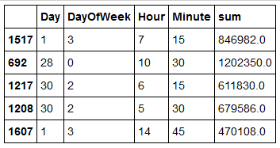
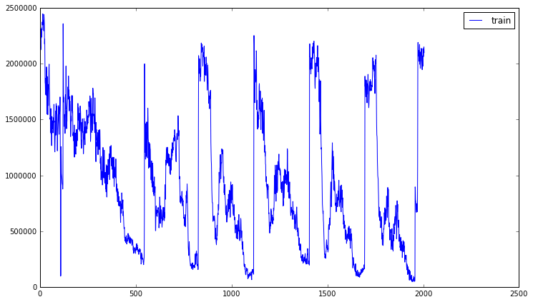
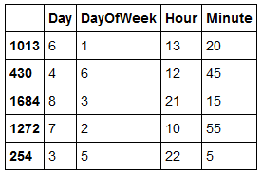
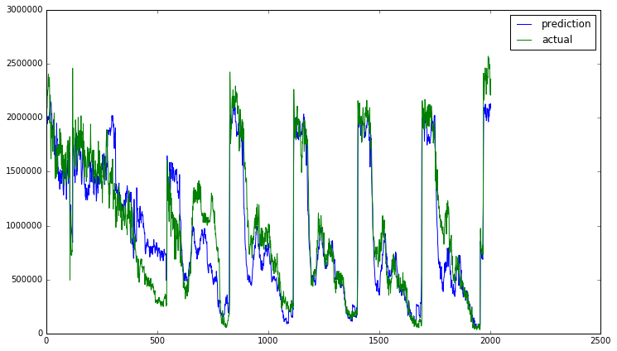
Appendix III - Appendix III - Database read/write prediction

Slide 31








Some interesting ML start ups
Uses data from any Git based code repository to help engineering leaders optimize work pattern.
Building high performance sales teams
Fast punch tracking
Mine audio data
Building affordable medical diagnosis solutions using a microscope slides
News analytics for trading
Earth observation imagery
Human Resource
Management

